Slide 1
Transformation of the Cartesian Plane

Slide 2
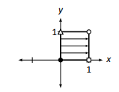
Transitioning to a New Topic
Now we will multiply every vector in the Cartesian plane by a matrix A instead of just an individual vector.
Because of the Distributive Property, the Cartesian plane will be transformed in a very nice, predictable way.
One way of studying how the whole Cartesian plane is affected by multiplication by matrix A is to study how the unit square is affected.
Each unit square corner can be represented by a vector that points to it; multiply each of these vectors by A
and we get an idea of how A affects the whole Cartesian plane.
Page 2

Slide 3

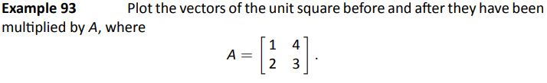
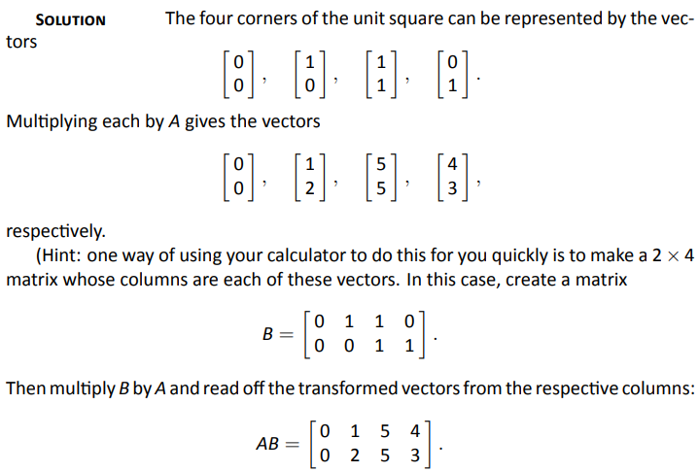
Example 93
Problem
Solution
Page 3

Slide 4
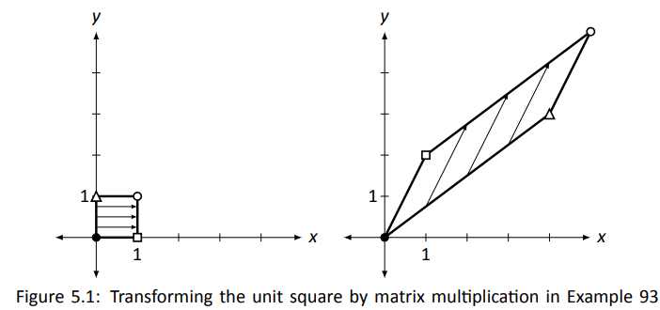
Example 93
Problem
Problem
A really interesting thing is how the triangular and square vertices seem
to have changed places – it is as though the square, in addition to being
stretched out of shape, was flipped.
Solution
Note the arrows inside the squares. Note that relative distances have been preserved.
Page 4

Slide 5

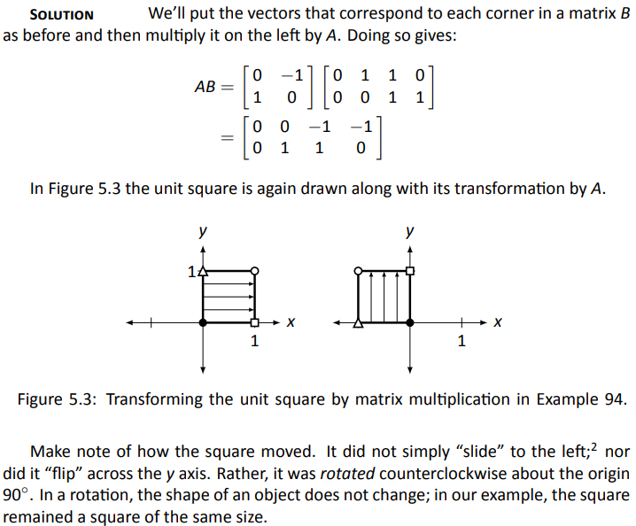
Example 94
Plot the transformed unit square after it has been transformed by A, where
Problem
Solution
Page 5

Slide 6
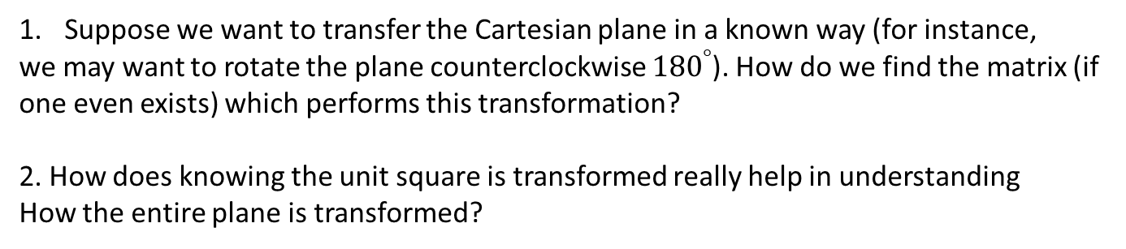
Questions to Consider
We have broached the topic of how the Cartesian plane can be transformed via multiplication by a 2×2 matrix A
Suppose we want to transfer the Cartesian plane in a known way (for instance,
we may want to rotate the plane counterclockwise ${180}^{°}$). How do we find the matrix (if
one even exists) which performs this transformation?
2. How does knowing the unit square is transformed really help in understanding
How the entire plane is transformed?

Slide 7
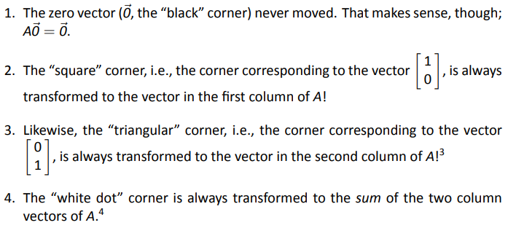
Groundwork for Answering Questions
Explanation given
on next slide
Page 7

Slide 8
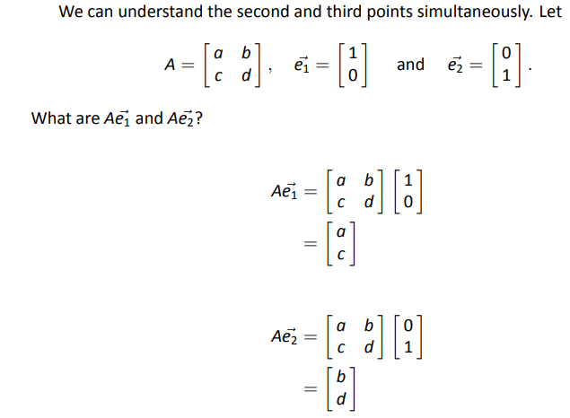


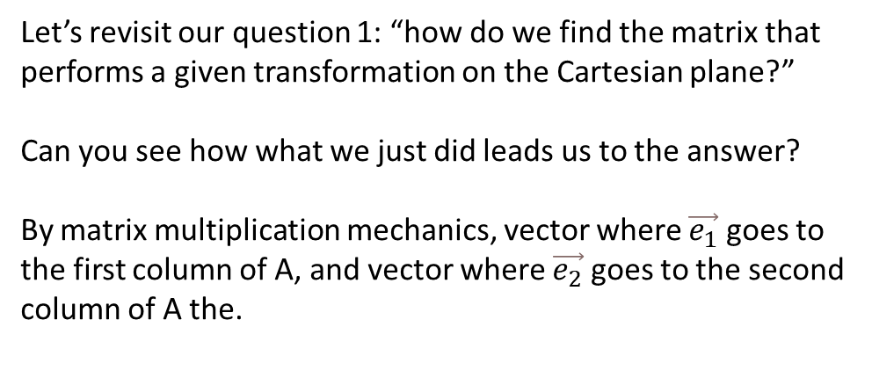


Further explanation
$$\left[\begin{matrix}1 \\ 0\end{matrix}\right]$$
$$\left[\begin{matrix}a \\ c\end{matrix}\right]$$
$$\left[\begin{matrix}0 \\ 1\end{matrix}\right]$$
$$\left[\begin{matrix}b \\ d\end{matrix}\right]$$
Let’s revisit our question 1: “how do we find the matrix that performs a given transformation on the Cartesian plane?”
Can you see how what we just did leads us to the answer?
By matrix multiplication mechanics, vector where $\vec{e_{1}}$ goes to the first column of A, and vector where $\vec{e_{2}}$ goes to the second column of A the.

Slide 9
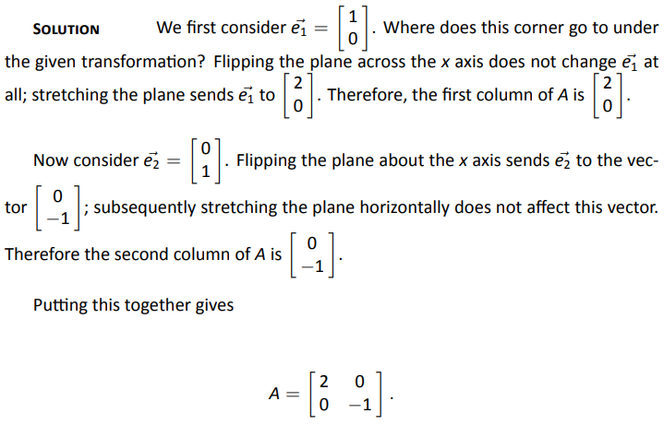
Example 95
Problem

Slide 10
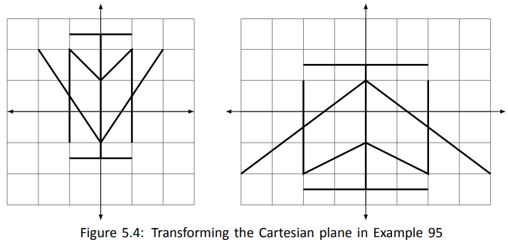

Example 95
Problem
Solution
$$A=\left[\begin{matrix}2 & 0 \\ 0 & −1\end{matrix}\right]$$

Slide 11
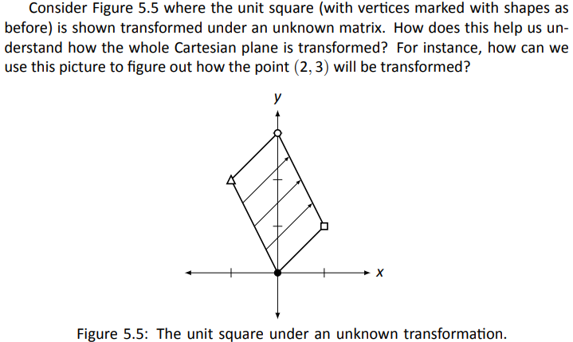

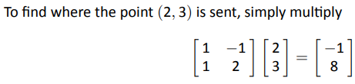
Transformation of a Point : Method 1
Page 11

Slide 12
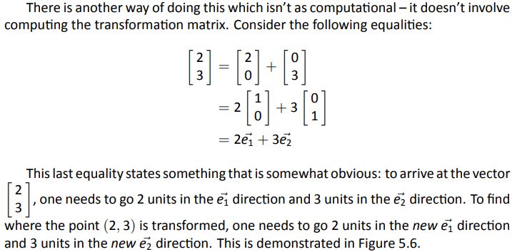
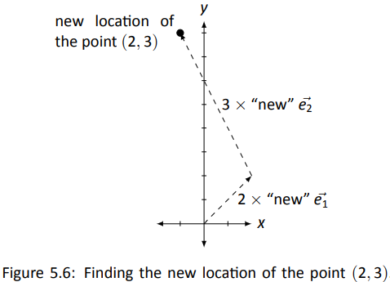
Transformation of a Point : Method 2
Page 12

Slide 13
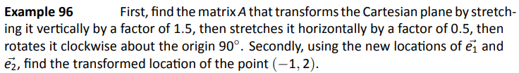
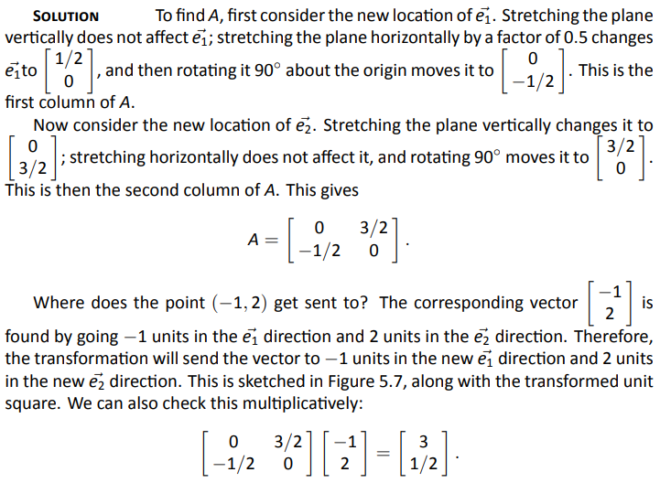
Example 96
Problem

Slide 14
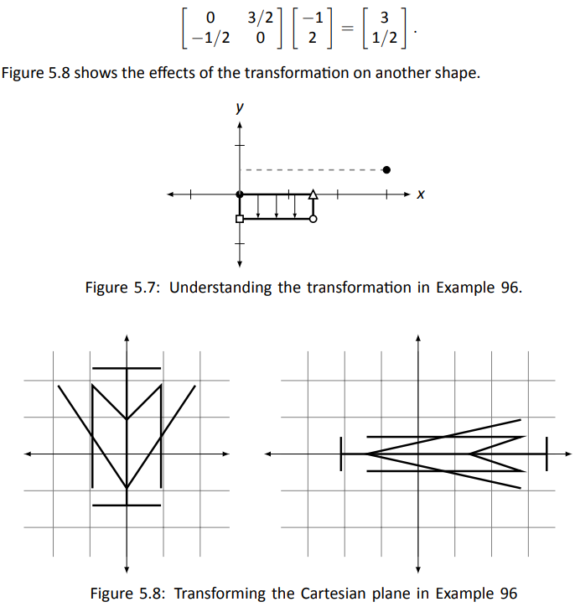
Example 96
Problem
Solution

Slide 15
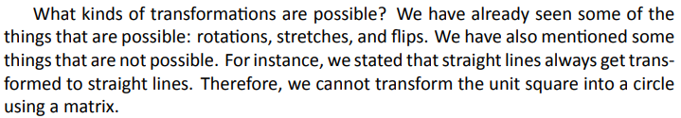
2D Matrix Transformations
The original unit square will be drawn lightly as well to serve as a reference in the slides ahead.

Slide 16
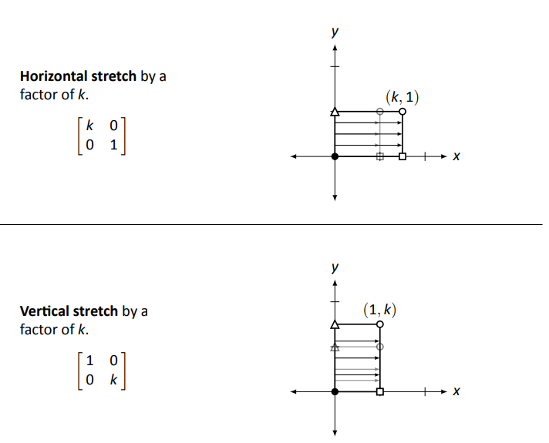
Stretches

Slide 17
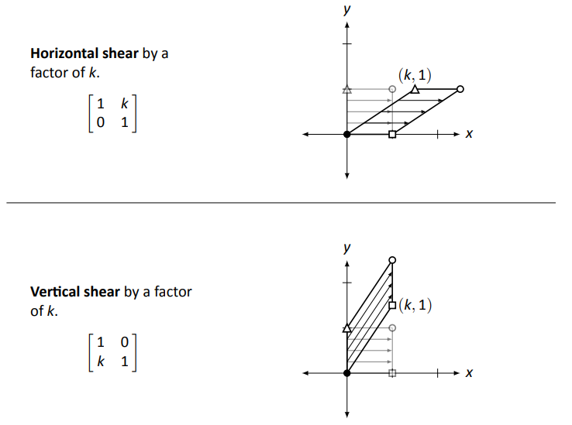
Shears

Slide 18
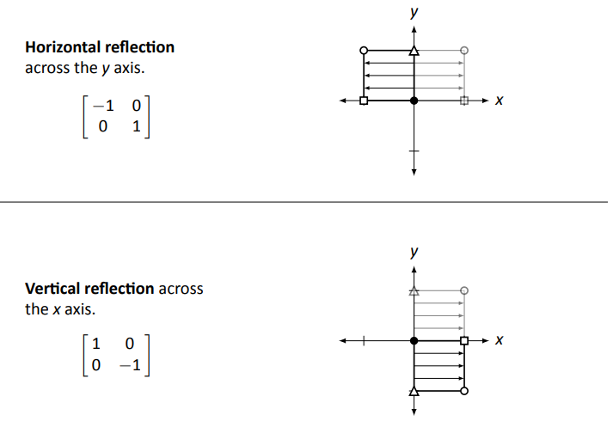
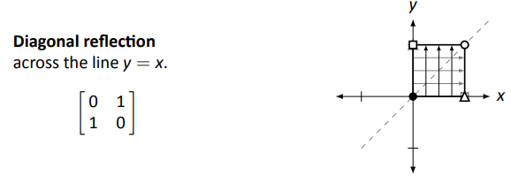
Reflections

Slide 19
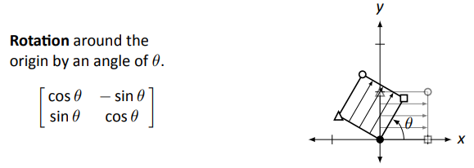
Rotation

Slide 20
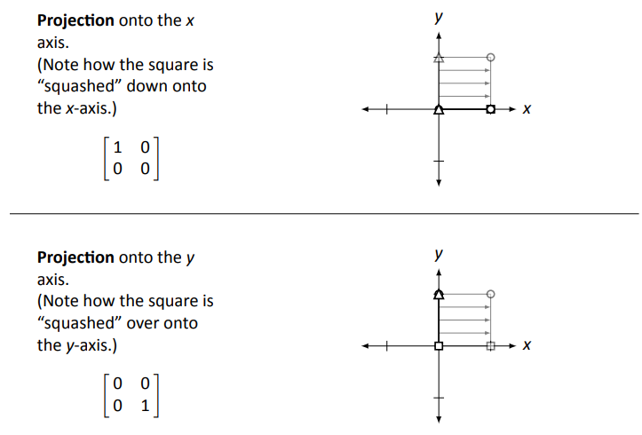
Projections

Slide 21
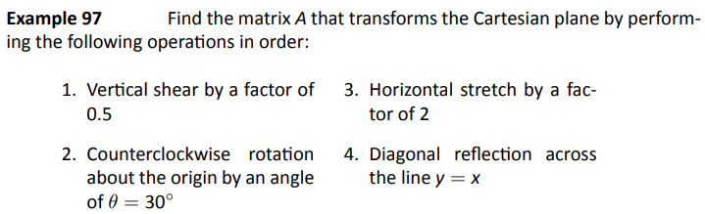
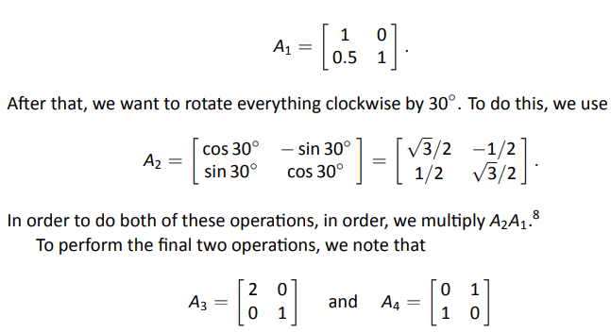
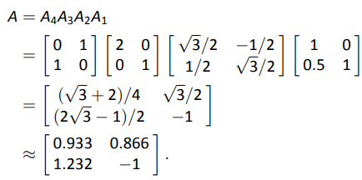
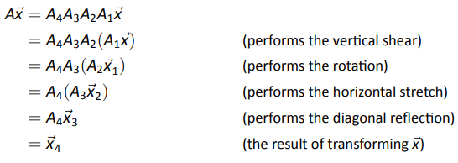

Example 97
Problem
Solution

Slide 22
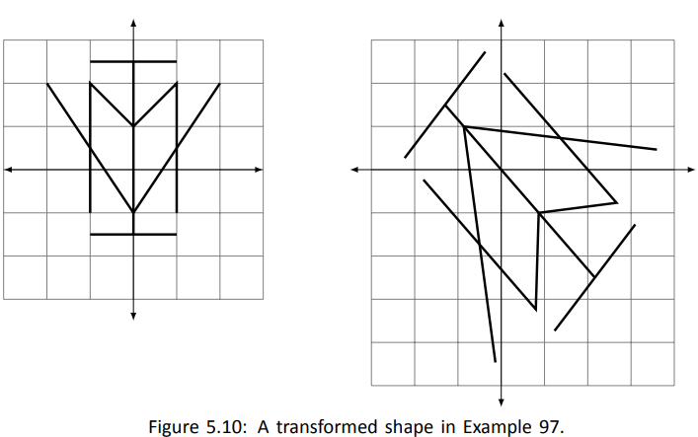
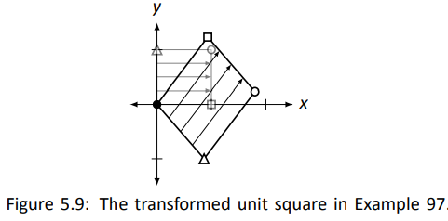

Example 97
Problem
Solution
Once we know what matrices perform the basic transformations,
performing complex transformations on the Cartesian plane really
isn’t that . . . complex. It boils down to multiplying by a series of matrices.

Slide 23
5.2 Properties of Linear Transformation

Slide 24
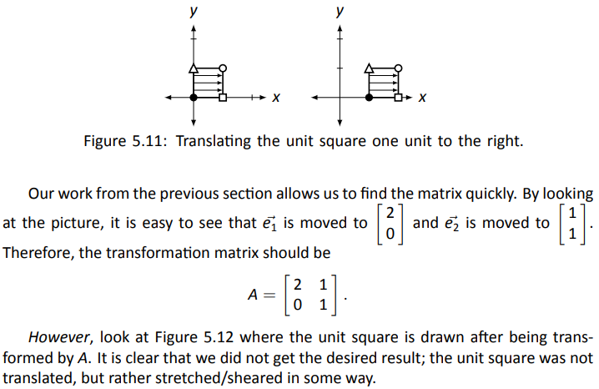
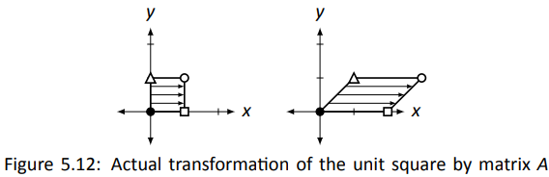
Translation vs Transformation

Slide 25

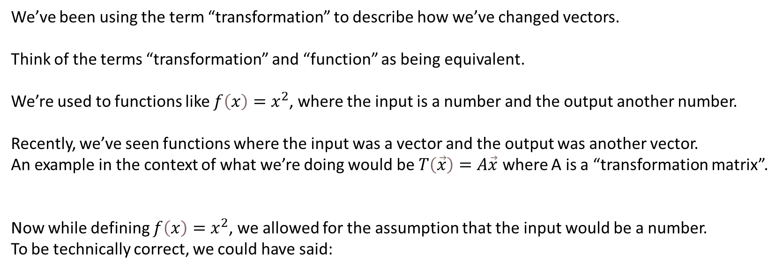
Transformation = Function
We’ve been using the term “transformation” to describe how we’ve changed vectors.
Think of the terms “transformation” and “function” as being equivalent.
We’re used to functions like $f\left(x\right)=x^{2}$, where the input is a number and the output another number.
Recently, we’ve seen functions where the input was a vector and the output was another vector.
An example in the context of what we’re doing would be $T\left(\vec{x}\right)=A\vec{x}$ where A is a “transformation matrix”.
Now while defining $f\left(x\right)=x^{2}$, we allowed for the assumption that the input would be a number.
To be technically correct, we could have said:

Slide 26
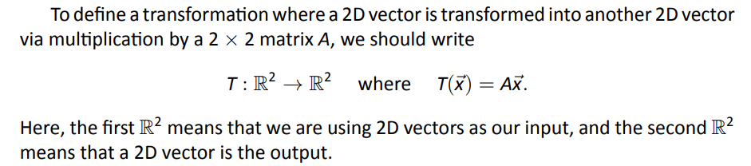
Transformation = Function
The first and second $ℝs$ tells us that the input and output (respectively) were real numbers.

Slide 27
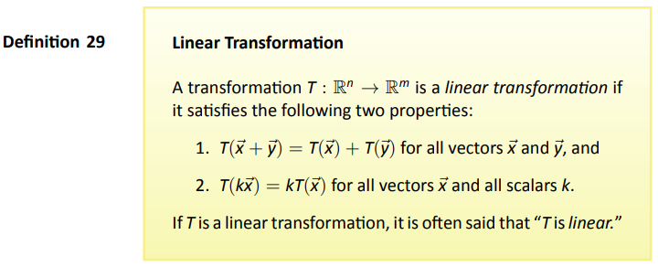
Definition

Slide 28
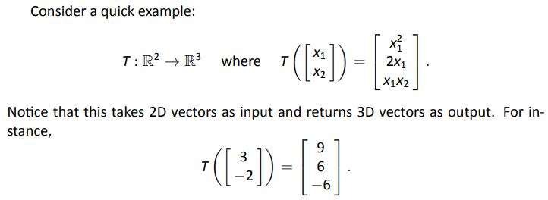
Linear Transformation?

Slide 29
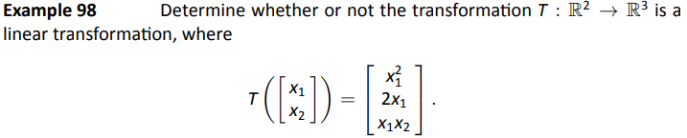
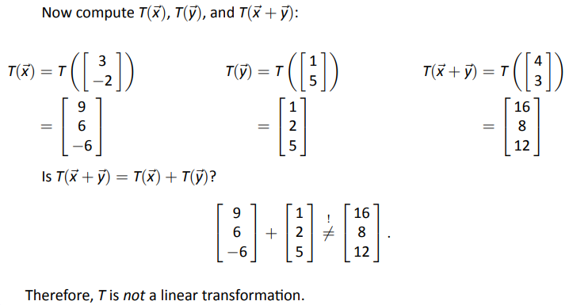
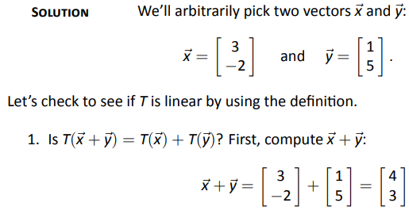
Example 98
Problem
Problem
Solution

Slide 30
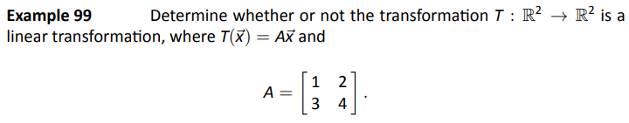
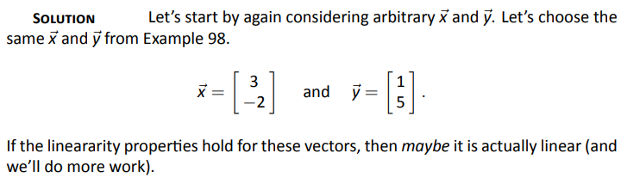
Example 99
Problem
Solution

Slide 31
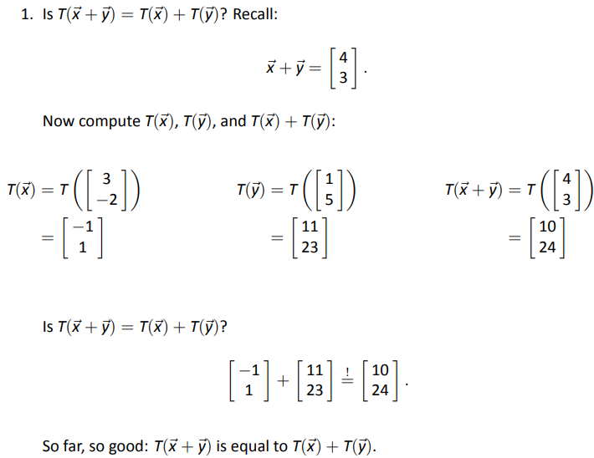
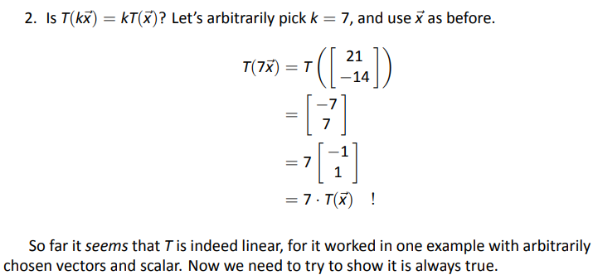
Example 99
Problem
Problem
Solution

Slide 32
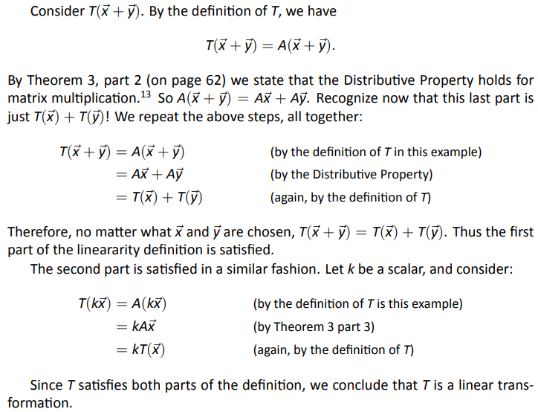
Example 99
Problem
Problem
Solution

Slide 33
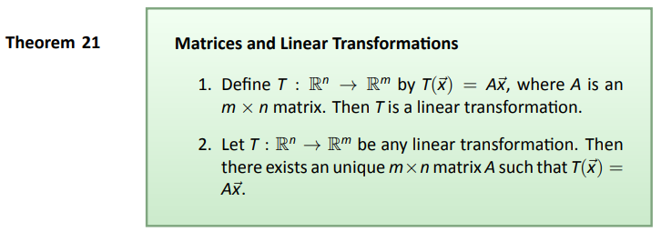
Theorem
Note: the second part of the theorem says that all linear transformations
can be described using matrix multiplication

Slide 34
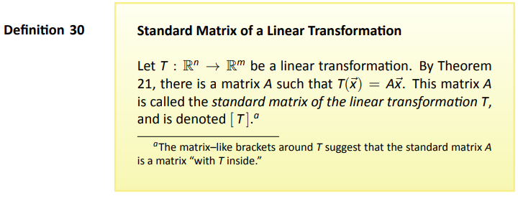
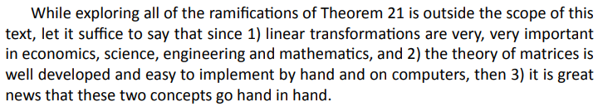
Definition

Slide 35
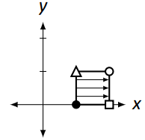
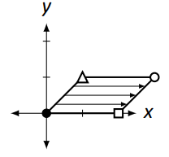

Revisiting Our Original Example
vs
Remember the example at the beginning of this section?
We might have guessed things went wrong because “the translation transformation was not a linear transformation.”
While true, this doesn’t explain things very well.
Let’s call our attention to the second part of the linear transformation definition.
It states $T\left(k\vec{x}\right)=kT\left(\vec{x}\right)$ for all scalars k.
If we let k = 0, we have $T\left(O\vec{x}\right)=O∙T\left(\vec{x}\right)$, or more simply, $T\left(\vec{0}\right)=\vec{0}$.
In other words, if T is to be a linear transformation, it must send the zero vector to the zero vector.

Slide 36



Revisiting Our Original Example (cont)
In this way, we can quickly see that a translation transformation fails to be linear.
In our example again, we shifted the unit square one to the right. By doing so, the corner
At point (0,0) was sent to the point (1,0), i.e.,
Due to the importance of this is property, it will be highlighted on the next slide.

Slide 37


Key Idea

Slide 38


Examples of this Definition:

Slide 39

Theorem

Slide 40


Example 100
Problem
Solution

Slide 41


Example 100
Problem
Check

Slide 42




Example 101
Problem
Setup
T
=

Slide 43

Example 101
Problem
Wrap up

Slide 44




Linear Transformation?
Reasoning

Slide 45


Key Idea

Slide 46



Example 102
Problem
Solution

